Slide 1
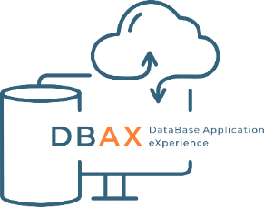



Managing successful digital initiatives
Ilia Ryzhkov
DBAX
Neil Hayes-Webster
Somerset NHS Foundation Trust

Slide 2
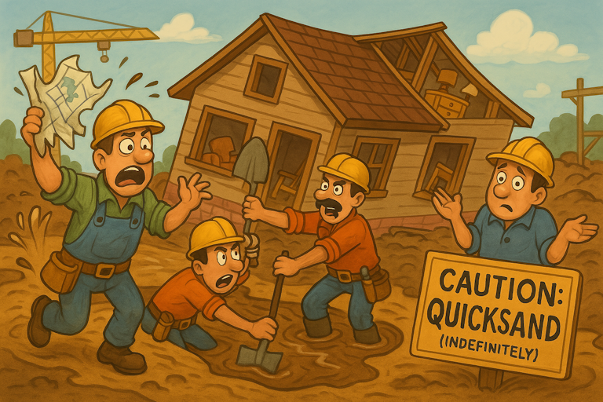







You Can't Build a House on Quicksand
"You can't build a home on quicksand
- or a lasting digital infrastructure on shaky foundations“
NHS data challenges:
Mergers, legacy and disconnected systems
Version Control
Everything as Code
CI/CD Pipelines
Testing
Open Source First
Reference Architecture
Security by Design
Notes:
We wanted to start with a warehouse. A true home for your businesses data. So with a love of DIY and home renovation, we thought it would be nice to start with a "ware house" and liken our data position to that of construction so to quote a colleague …
"You can't build a House on quicksand - or a lasting digital infrastructure on shaky foundations“
Building a Home on Sand is the situation we find ourselves in today:
With Trust mergers, system integration and redirection from government we have some seriously shifting sands these days. Imagine trying to build your dream home—something smart, safe and future-ready— but where the ground beneath is soft and unstable. No matter how well-designed your house is, cracks will appear, systems won’t work properly, and it won’t stand the test of time. That's the situation the NHS faces with its data infrastructure today.
Fragmented and Inconsistent Data are our Unstable Foundations:
NHS data being scattered across lots of different systems — GPs, hospitals, social care
There is'nt a single, stable base.
Inconsistent formats and standards mean those systems can’t talk to each other,
like trying to connect metric and imperial pipes that just don’t fit.
Data Quality Issues speak to Poor Building Materials:
With the best will in the world, many datasets we have to use are incomplete, outdated, or inaccurate.
That leads to poor decisions, like building with warped timber or cracked bricks
If you can’t trust the structure you won't trust the output, GIGO.
Digital Maturity Gaps in unreliable materials create wonky walls:
Some areas of the NHS are high-tech, others still relying on old fashioned paper records and this can exist in the same organisation.
It’s like having a smart new kitchen in a house with a great gas cooker but no gas to run it
the parts just don’t work together.
Similarly Legacy Systems are our Outdated Fixtures:
Many NHS systems are inherited with old or hard to upgrade technology, its like trying to install modern appliances in a house with 1950s sockets.
These systems continue to need to be used so slow everything down and increase the risk of failure.
Finally we have our Lack of Skilled Builders: our Workforce and Culture are a limitation
There’s a real shortage of technically-skilled staff and a culture that doesn’t always value data or the skills behind it.
Even the best tools won’t help if the builders aren’t trained or they don’t trust the blueprints. You wouldn’t start building a house without the right skills.
What we Need to look at is creating a sound and Solid platform, we need to think differently
To build a home that’s safe, smart, and sustainable, the NHS needs to start from the ground up:
Leveling the ground with interoperable systems and shared records.
Improving the materials by improving the data accuracy and completeness.
Training our builders—invest in digital skills and leadership.
Build trust in the data with strong governance and transparency.
Only then can we create a health system that’s not just functional, but a true home for innovation and care.
VECTORS aims to give us a starting point to provide these tools for the future.

Slide 3
VECTORS Framework:
Seven core pillars that support successful digital transformation in healthcare.
Version Control
Everything as Code
CI/CD Pipelines
Testing
Open Source First
Reference Architecture
Security by Design
Notes:
VECTORS Framework:
Seven core pillars that support successful digital transformation in healthcare.
Enables NHS Trusts or other organisations to build resilient and future-proof data platforms that can adapt to changes and new system procurements.
Framework Introduction (5 mins) - Ilya
The Seven Pillars that support any digital house
"Today we'll examine each foundation pillar that separates thriving organisations from struggling ones"
VECTORS stands for seven foundational pillars:
Version Control
Everything as Code
CI/CD Pipelines
Testing
Open Source First
Reference Architecture
Security by Design

Slide 4

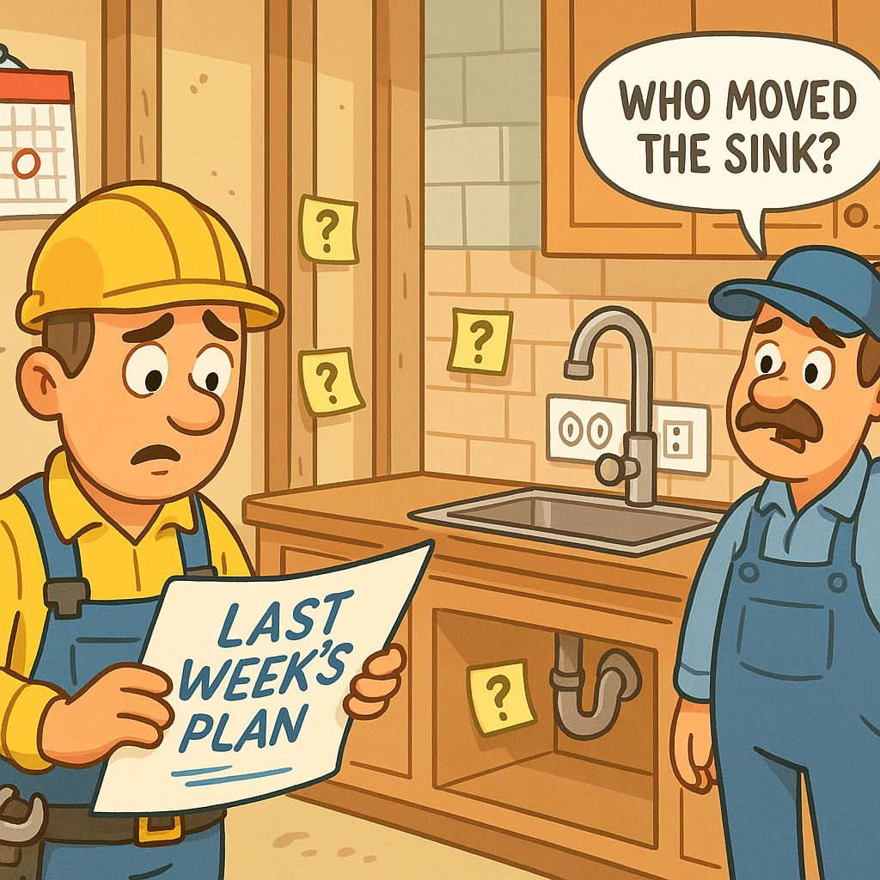

Version Control - The House Plans
Version Control
Version control
GIT
"Every change to the blueprints tracked and approved “
Security by Design
Reference Architecture
Open Source First
Testing
CI/CD Pipelines
Everything as Code
Notes:
Every change to the blueprints tracked and approved
Shaky Foundations: "The electrician wired the kitchen based on last week's plans, but someone moved the sink location and forgot to tell anyone. Now there are power outlets under where the tap will be, and nobody remembers who decided to move the sink or why."
Solid Foundation: Gold standard is to Imagine building a house where every single change to the blueprints is recorded in a master logbook. If the architect decides to move a door, it's documented: who made the change, why, when, and exactly what was modified. If the builder discovers the new door placement won't work, they can still see the original design and revert back. Multiple architects can work on different sections simultaneously without overwriting each other's work. The foreman can see exactly what's changed between yesterday's plans and today's before starting work.
Our Technical Solution: to this is Version control something like Git or a similar product, these track every change to code, configurations, don’t forget to include the documentation, we need that as well. Collaborative working through remote Git repositories enables disparate teams to work together whilst coding safely - creating feature branching for new code, merging with peer review and approval, and rolling back when needed.
"With approved plans in hand, we move to creating the digital design..."

Slide 5

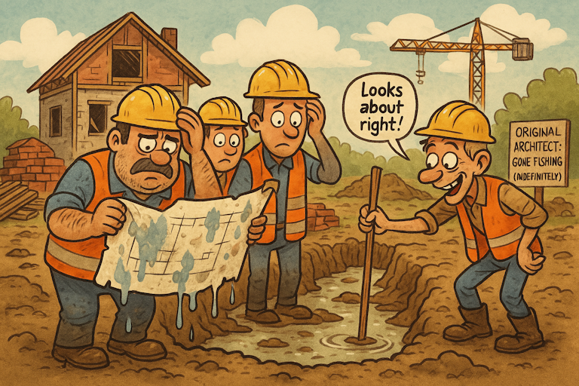
Everything as Code - The Digital Design
Everything as Code
Infrastructure as Code
Terraform, dbt, SQLMesh
"House plans, permits, certifications - all stored electronically “
Reference Architecture
Security by Design
Version Control
CI/CD Pipelines
Testing
Open Source First
Notes:
Pillar 2: Ilya
"House plans, permits, certifications - all stored electronically"
Shaky Foundations: "The original architect left the company, taking his knowledge with him. The hand-drawn plans are water-damaged and illegible in crucial sections. The builders are guessing how deep the foundations should be based on 'what looks right.'"
Solid Foundation: Rather than keeping blueprints as paper drawings that can be lost, damaged, or misinterpreted, everything is stored as precise digital specifications. The foundation depth, concrete mix ratios, pipe specifications, electrical standards - all defined in digital format that machines can read and execute exactly. If a storm destroys the building site, you can recreate the exact same house anywhere by running the digital specifications through construction equipment. No human interpretation errors, no "I think it was supposed to be like this."
Technical Explainer: Infrastructure as Code using Terraform for cloud resources, SQL databases with SSDT (SQL Server Data Tools) for version-controlled database schemas, and dbt or SQLMesh for data transformations. Everything is defined in readable code files that can be reviewed, tested, and versioned. Avoid black-box tools like SSIS packages where you can't see what's happening inside - if you can't read it, you can't maintain it reliably.
Transition: "Digital designs flow through our automated plumbing system..."

Slide 6

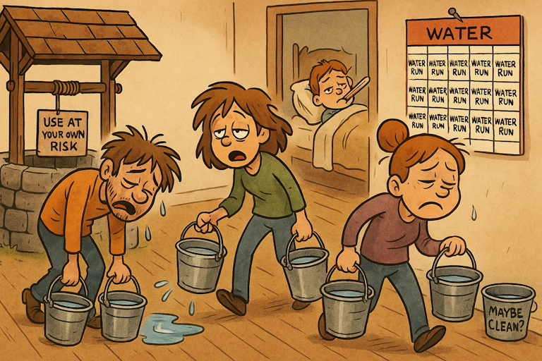
CI/CD Pipelines - The Plumbing System
CI/CD Pipelines
Automation
Github Actions.
"Automated pipes that deliver clean water and remove waste “
Security by Design
Open Source First
Reference Architecture
Version Control
Everything as Code
Testing
Notes:
Pillar 3 - Iliya
"Automated pipes that deliver clean water and remove waste"
Shaky Foundations: "Water is carried manually in buckets from the well to each room. Sometimes the water is clean, sometimes it's contaminated, but you only find out after someone gets sick. Moving water is exhausting work that takes all day, leaving no time for anything else."
Solid Foundation: Your house has intelligent plumbing that automatically tests water quality before it reaches any taps. If contaminated water enters the system, automatic valves shut off flow until the problem is fixed. Clean water flows smoothly from the source through filtering, quality testing, and final delivery to every room. The system monitors itself - if pressure drops or impurities are detected anywhere, warning lights show exactly where the problem is. No contaminated water ever reaches the residents.
Technical Explainer: Continuous Integration/Continuous Deployment pipelines using tools like Azure Pipelines, GitLab CI, or GitHub Actions. When code is committed, automated systems build it, test it, scan for security issues, and deploy it through staging to production. No manual steps, no forgotten configurations, no human errors in deployment.
Transition: "But before anything flows to residents, it must pass electrical inspection..."

Slide 7



Testing - The Electrical Inspection
Testing
Automated Testing
multiple levels
Regression, Unit, Data Quality
"Every wire tested before the power goes live “
Security by Design
Open Source First
Reference Architecture
Version Control
CI/CD Pipelines
CI/CD Pipelines
Everything as Code
Notes:
"Every wire tested before the power goes live"
Shaky Foundations: "Our Electricity is connected hopefully, with fingers crossed. Sometimes lights work, sometimes they don't. Occasionally outlets spark or circuit breakers trip randomly. The family has learned to check every switch carefully and keep torches handy for when things fail unexpectedly."
Solid Foundation: Before any electricity flows through the house, every single wire, connection, and component should be rigorously tested. Automated testing equipment checks voltage levels, identifies shorts, verifies safety switches work. The testing is so thorough that when you flip a light switch for the first time, you're absolutely confident it will work safely and as intended. If any component fails testing, the system identifies exactly which wire or connection needs fixing before power can be enabled.
Technical Explainer: We do this via automated testing at multiple levels
Unit tests for individual functions
Regression tests to compare outputs,
Data quality testing that validates schemas, checks for missing values, and ensures consistency.
You can include logic tests here as well. End dates before start dates or overlapping values.
All tests can run automatically before any deployment reaches production.
"With safety certified, we can then source materials from reliable building supplies..."

Slide 8

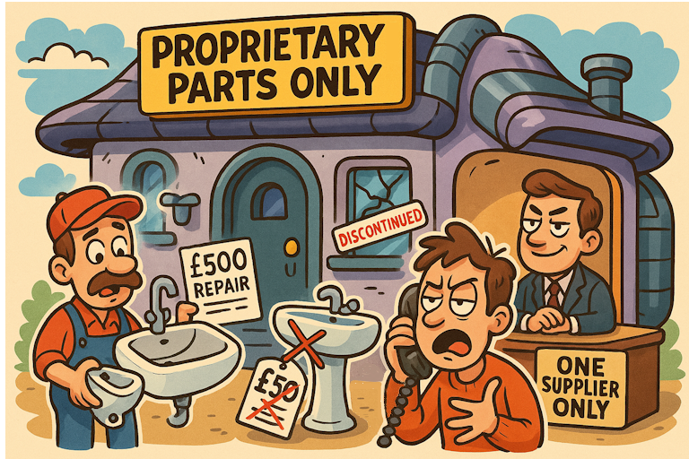
Open Source First - The Building Supplies
Open Source First
Open source providers
Python, GIT, ANSI SQL
No lock-in
"Standard bricks, standard fittings - never locked to one supplier “
Security by Design
Reference Architecture
Version Control
Testing
CI/CD Pipelines
Everything as Code
Notes:
Pillar 5: Ilia
"Standard bricks, standard fittings - never locked to one supplier"
Solid Foundation: Your house is built using standard materials available from multiple suppliers. The bricks are standard size, so any brick manufacturer can provide replacements. The plumbing uses standard fittings, so any plumber can work on them with normal tools. If your usual supplier goes out of business or raises prices unreasonably, you can switch to another supplier immediately without rebuilding anything. The materials are proven designs used in thousands of other houses, with extensive community knowledge about best practices.
Shaky Foundations: "Your house is built with proprietary materials available from only one supplier. When the sink breaks, only that company can fix it - and they charge £500 for a repair that would cost £50 with standard parts. When they decide to discontinue your window type, you can't get replacements. You're trapped."
Technical Explainer: Prioritising open source solutions whenever possible to avoid vendor lock-in and costly licence spikes. Not possible everywhere for various reasons, but an ingestion algorithm can be built in Python rather than expensive proprietary platforms. Open source provides access to source code, community support, and freedom to modify. Multiple vendors can support the same open source technology, preventing lock-in.
Transition: "All these different supplies connect through our consumer unit..."

Slide 9

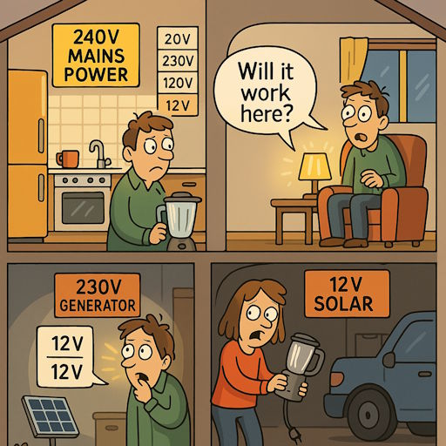
Reference Architecture - The Consumer Unit
Reference Architecture
Common Data Models
NHS Data Dictionary
"Despite different voltage inputs - mains, solar, generator - all devices get standard 240V power “
Security by Design
Open Source First
Version Control
Testing
CI/CD Pipelines
Everything as Code
Notes:
"Every wire tested before the power goes live"
Shaky Foundations: "Our Electricity is connected hopefully, with fingers crossed. Sometimes lights work, sometimes they don't. Occasionally outlets spark or circuit breakers trip randomly. The family has learned to check every switch carefully and keep torches handy for when things fail unexpectedly."
Solid Foundation: Before any electricity flows through the house, every single wire, connection, and component should be rigorously tested. Automated testing equipment checks voltage levels, identifies shorts, verifies safety switches work. The testing is so thorough that when you flip a light switch for the first time, you're absolutely confident it will work safely and as intended. If any component fails testing, the system identifies exactly which wire or connection needs fixing before power can be enabled.
Technical Explainer: We do this via automated testing at multiple levels
Unit tests for individual functions
Regression tests to compare outputs,
Data quality testing that validates schemas, checks for missing values, and ensures consistency.
You can include logic tests here as well. End dates before start dates or overlapping values.
All tests can run automatically before any deployment reaches production.
"With safety certified, we can then source materials from reliable building supplies..."

Slide 10

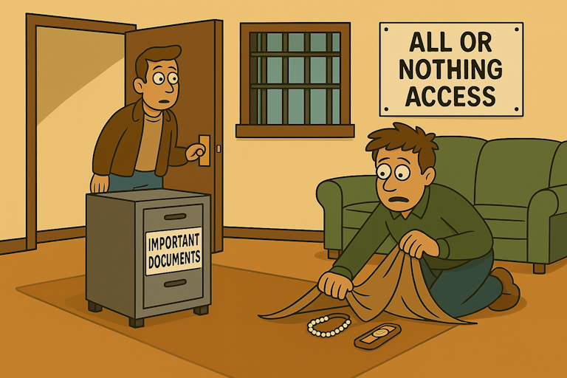
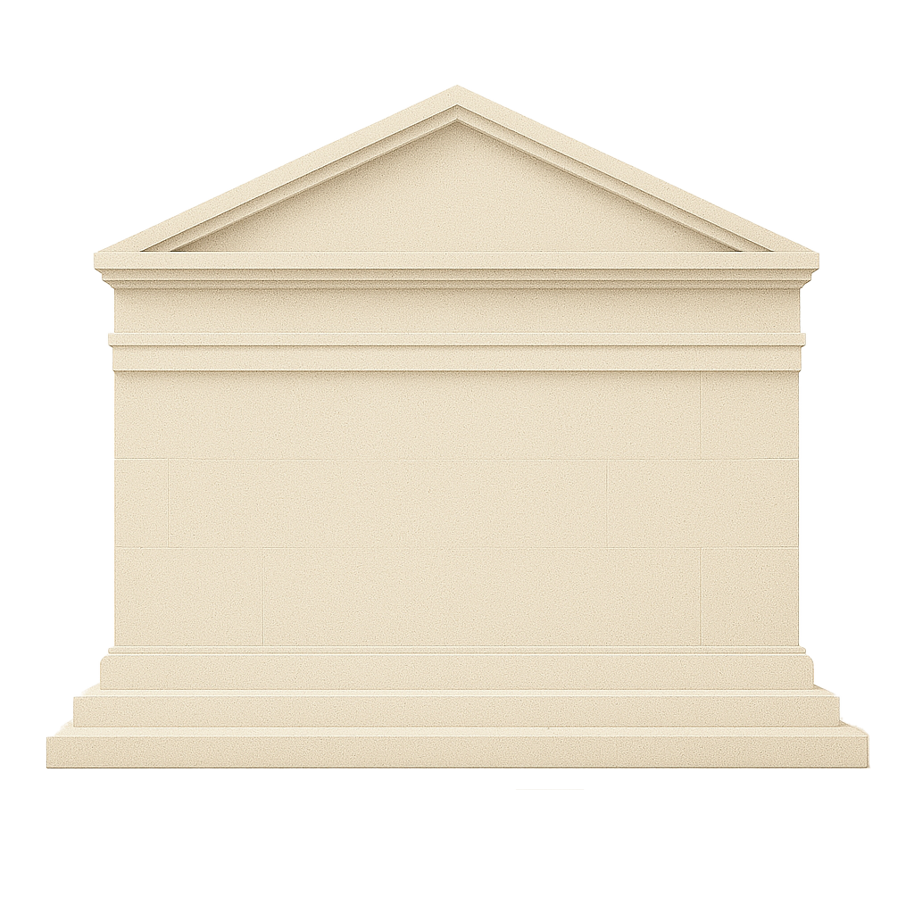
Security by Design - The Security System
Security by Design
Separation of PII
Granular permissions
"Smart locks that recognise residents but stop burglars“
Open Source First
Reference Architecture
Version Control
Testing
CI/CD Pipelines
Everything as Code
Notes:
Pillar 7 - Ilya
"Smart locks that recognise residents but stop burglars"
Solid Foundation: Your house has intelligent security built into its very structure. The locks recognise family members automatically and grant appropriate access - parents can enter any room, children can't access the workshop, guests are limited to common areas. The system knows who should be where and when. Sensitive rooms like the home office containing financial documents have additional protection, but family members with legitimate access aren't inconvenienced. Security is invisible to authorised users but impenetrable to those who shouldn't be there.
Shaky Foundations: "Security is an afterthought - a simple deadbolt on the front door and bars on the windows. Everyone either has access to everything or access to nothing. The filing cabinet with important documents sits in the living room because there's nowhere secure to put it. When guests visit, you hide valuables and hope for the best."
Technical Explainer: For data engineering, security means PII data is within different schemas with access only by those who need it. Sensitive patient information is segregated from general reporting data, with granular permissions controlling who can access what level of detail.

Slide 12
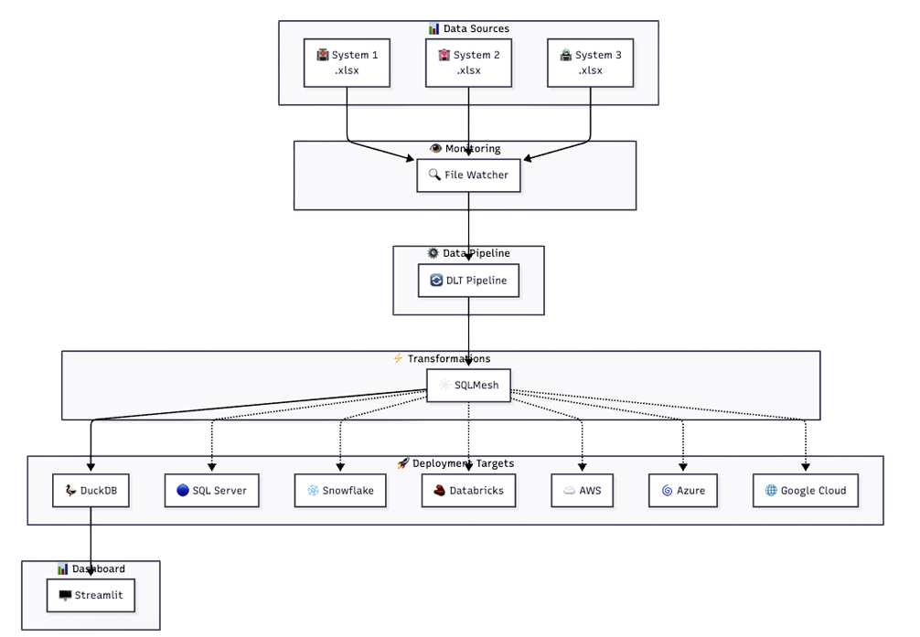
DEMO
Security by Design
Open Source First
Reference Architecture
Version Control
Testing
CI/CD Pipelines
Everything as Code

Slide 13

CASE STUDY
Somerset Foundation Trust
Merger in 2023 and approach to challenges
Integration for the future.
Notes:
Trust merger challenges (multiple patient admin systems)
Siloed data sources; duplicated code and different logic for similar workflows. Inconsistent metrics.
New EHR integration strategy
Data migration backend feeding

Slide 14
SFT Case Study
Design Overview
Data Insight and Intelligence
Neil Hayes-Webster

Slide 15
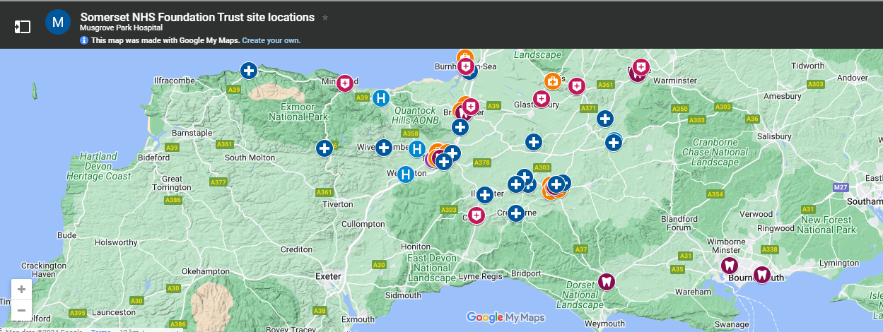


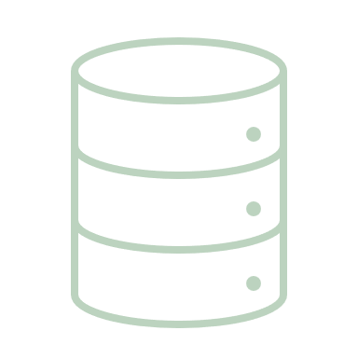

Design Overview
13 Production Warehouse and reporting Servers
Over 250 Databases
Fed from 148 clinical and corporate systems
Neil Hayes-Webster

Slide 16




Design Overview
Create a reusable template for the future.
Introduce new concepts
GITHUB
Version Control
Peer Review
Introduce ‘RAP’
Infrastructure as code
Improve performance and reliability
Near Real Time
Reduce silo working
Community
Mental Health
Acute Yeovil
Acute Taunton
13 Production Warehouse and reporting Servers
Over 250 Databases
Fed from 148 clinical and corporate systems
Neil Hayes-Webster

Slide 17




Data Engineering
Test new platforms and processes
Deliver data in a clear and transparent warehouse
Automate National returns and other requests to save time
Focus on ED Data
Development Objectives
Reduce silo working
Community
Mental Health
Acute Yeovil
Acute Taunton
Improve performance and reliability
Near Real Time
Introduce new concepts
GITHUB
Version Control
Peer Review
Introduce ‘RAP’
Infrastructure as code
Create a reusable template for the future.
Fed from 148 clinical and corporate systems
Over 250 Databases
13 Production Warehouse and reporting Servers
Neil Hayes-Webster

Slide 18




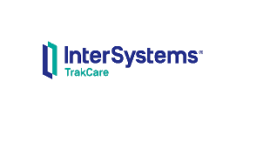

Data Engineering
Development Objectives
Focus on ED Data
Automate National returns and other requests to save time
Deliver data in a clear and transparent warehouse
Test new platforms and processes
Tools
Development Cycle
Deployment Process
Maxims
TrakCare
Oceano
Neil Hayes-Webster
Create a reusable template for the future.
Introduce new concepts
GITHUB
Version Control
Peer Review
Introduce ‘RAP’
Infrastructure as code
Improve performance and reliability
Near Real Time
Reduce silo working
Community
Mental Health
Acute Yeovil
Acute Taunton

Slide 19

Design Overview
Warehouse Approach
Tools
Development Cycle
Deployment Process
Test new platforms and processes
Deliver data in a clear and transparent warehouse
Automate National returns and other requests to save time
Neil Hayes-Webster
Focus on ED Data

Slide 20


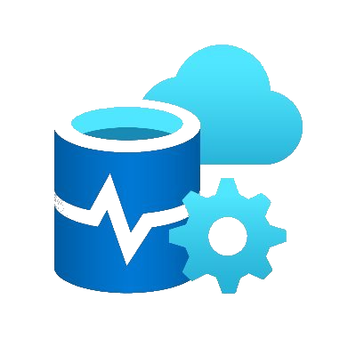





Design Overview
Draw.io
Visual Studio Code
Azure Data Studio
GITHUB
GIT
Warehouse Toolset
Tools
Neil Hayes-Webster
Learning Material
Deployment Process
Development Cycle
Configuration

Slide 21
Design Overview
Free Open source
Version control management
Tracks Changes
Allow developers to work on same file at same time and not lose their work
Allows parallel development
Warehouse Toolset
Tools
GIT
GITHUB
Visual Studio Code
Azure Data Studio
Neil Hayes-Webster

Slide 22
Design Overview
Cloud based hosting service for Git Repositories
Easier to collaborate
Project management
Support ticket management
Warehouse Toolset
GIT
Free Open source
GITHUB
Azure Data Studio
Visual Studio Code
Draw.io
Version control management
Tracks Changes
Allow developers to work on same file at same time and not lose their work
Allows parallel development
Neil Hayes-Webster

Slide 23
Design Overview
CLONE: Create local copy of project
BRANCH: Create working area linked to issue
or feature
COMMIT: Save work back to GIT environment
PULL REQUEST: Submit for review and comment
MERGE: Blends code into MAIN Repository
Warehouse Toolset
Cloud based hosting service for Git Repositories
Free Open source
GIT
GITHUB
Easier to collaborate
Version control management
Tracks Changes
Project management
Allow developers to work on same file at same time and not lose their work
Support ticket management
Allows parallel development
Neil Hayes-Webster

Slide 24
Design Overview
Built on Open source
Streamlined code editor
Integrated Development Environment
Expandable: SQL, Python, C++
Warehouse Toolset
CLONE: Create local copy of project
Cloud based hosting service for Git Repositories
Visual Studio Code
Azure Data Studio
GIT
GITHUB
BRANCH: Create working area linked to issue
or feature
Easier to collaborate
COMMIT: Save work back to GIT environment
Project management
PULL REQUEST: Submit for review and comment
Support ticket management
MERGE: Blends code into MAIN Repository
Neil Hayes-Webster

Slide 25
Design Overview
Diagramming software
Export
Collaborate on flowcharts
Warehouse Toolset
Draw.io
GIT
GITHUB
Visual Studio Code
Azure Data Studio
Built on Open source
CLONE: Create local copy of project
Streamlined code editor
BRANCH: Create working area linked to issue
or feature
COMMIT: Save work back to GIT environment
Integrated Development Environment
PULL REQUEST: Submit for review and comment
Expandable: SQL, Python, C++
MERGE: Blends code into MAIN Repository
Neil Hayes-Webster

Slide 26

Design Overview
Development Cycle
Development Cycle
Built on Open source
Diagramming software
Draw.io
GITHUB
‘VS Code’ linked GITHUB
Streamlined code editor
Collaborate on flowcharts
Integrated Development Environment
Export
Expandable: SQL, Python, C++
Neil Hayes-Webster

Slide 27
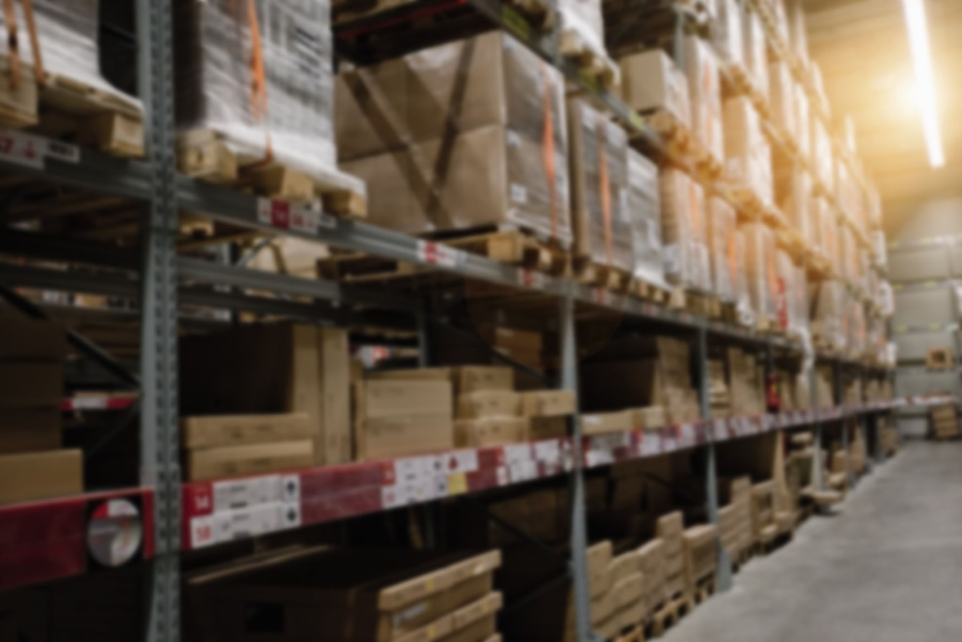
Design Overview
Deployment Process
Development Cycle
Merge
Defined Request
Approval
Create Branch
Warehouse
Code Review
Develop
Automated testing
Deploy to DEV
Pull Request
Neil Hayes-Webster
Development Cycle

Slide 28
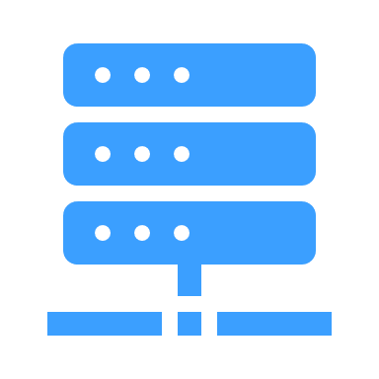

Design Overview
Deployment Process
Approx 2 Weekly
Deployment Process
SFT-WAREHOUSE/ARTEMIS
Deployment Process
SFT-DWHLIS
Neil Hayes-Webster

Slide 29
Design Overview
Learning Material
Deployment Process
Approx 2 Weekly
Deployment Process
SFT-WAREHOUSE/ARTEMIS
Deployment Process
Reduce silo working
Community
Mental Health
Acute Yeovil
Acute Taunton
Improve performance and reliability
Near Real Time
Introduce new concepts
GITHUB
Version Control
Peer Review
Introduce ‘RAP’
Infrastructure as code
Create a reusable template for the future.
Maxims
Regression Testing
Stop production platform
Deploy and restart
New Warehouse
Create Release Code
Copy Production
Baseline data
Apply Release
Data compare
Review
TrakCare
SFT-DWHLIS
Oceano
Neil Hayes-Webster

Slide 30
Design Overview
Warehouse in practice
Maxims
New Warehouse
Presentation Layer
Business Layer
Extraction Layer
TrakCare
Oceano
Neil Hayes-Webster
Test new platforms and processes
Deliver data in a clear and transparent warehouse
Automate National returns and other requests to save time
Focus on ED Data

Slide 31
Design Overview
Warehouse in practice
Maxims
New Warehouse
TrakCare
Extraction Layer
Business Layer
Presentation Layer
Connect to source every few minutes
Pull Net Changes to
the EXTRACT Layer
Oceano
Neil Hayes-Webster

Slide 32
Design Overview
Extraction
Warehouse in practice
Extraction Layer
Business Layer
Presentation Layer
Maxims
Connect to source every few minutes
TrakCare
Pull Net Changes to
the EXTRACT Layer
Oceano
Dimensions
Facts
Calculations
Attributes
Neil Hayes-Webster

Slide 33
Design Overview
Warehouse in practice
Extraction Layer
Business Layer
Presentation Layer
Dimensions
Extraction
Connect to source every few minutes
Facts
Pull Net Changes to
the EXTRACT Layer
Calculations
Attributes
Neil Hayes-Webster
Maxims
TrakCare
Oceano

Slide 34

Design Overview
Extraction Layer
Business Layer
Presentation Layer
Warehouse in practice
Facts
Dimensions
Attributes
Calculations
Views
Attendance
Tracking
Anything….
Facts
Dimensions
Attributes
Calculations
Extraction
Attendance
Diagnoses
Tracking
…
Care Provider
Area
Injury intent
…
Defined value on dimension
Eg Business name
Resus area flag
…
Time in dept
Previous Attendance Count
Neil Hayes-Webster

Slide 35
Design Overview
Extraction Layer
Business Layer
Presentation Layer
Warehouse in practice
Facts
Dimensions
Attributes
Views
Attendance
Tracking
Anything….
Facts
Dimensions
Attributes
Calculations
Extraction
Calculations
dim.acuity_src
fact.attendance
acuity_id
acuity_system_business_key
acuity
system_id
attendance_id
arrival_dt
acuity_id
dim.acuity_ba
acuity_ba_id
acuity_id
a001_acuity_business_name
a036_is_resus
Neil Hayes-Webster
Time in dept
Previous Attendance Count
Defined value on dimension
Eg Business name
Resus area flag
…
Care Provider
Area
Injury intent
…
Attendance
Diagnoses
Tracking
…

Slide 36
Design Overview
Created a reusable template for the future.
Introduced new working concepts
GITHUB
Version Control
Peer Review
Extraction Layer
Business Layer
Presentation Layer
Improved access to datasets
Extraction
Facts
Dimensions
Attributes
Calculations
Views
Attendance
Tracking
Anything….
Challenged Silo thinking
Community
Mental Health
Acute Yeovil
Acute Taunton
Neil Hayes-Webster
Dimensions
Facts
Calculations
Attributes

Slide 37
Data Engineering
Successes
Challenged Silo thinking
Community
Mental Health
Acute Yeovil
Acute Taunton
Improved access to datasets
Introduced new working concepts
GITHUB
Version Control
Peer Review
Created a reusable template for the future.
Neil Hayes-Webster

Slide 38
SFT Case Study
Design Overview
Data Insight and Intelligence
Neil Hayes-Webster

Slide 39
Which pillars may be missing ?
Any Priorities regarding pillars ?

Slide 40
V E C T O R S
Enables a consistent approach to
building resilient, future-proof
data platforms that adapt to change.

Slide 41

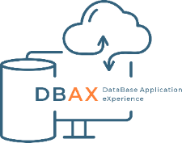
Managing successful digital initiatives
V E C T O R S
Scan to register for a follow-up demo
Ilia Ryzhkov
ilia.ryzhkov@dbax.co.uk
GITHUB: IliaRyzhkovPR
Neil Hayes-Webster
Neil.Hayes-Webster@SomersetFT.NHS.UK
GITHUB: NeilHW-NHS (NeilHW-SFT)
Notes:
Cartoon images created in Copilot.

